Slide 1
Helpdesk Ticket Auto Classifier
Derek Powell
Springboard – Data Science
Version: July 2022

Slide 2
Introduction
Detailed issue classification is costly and often inaccurate in a helpdesk environment
Inaccurate classification can make data unusable for detecting solutioning gaps and trending
As solution complexity increases, achieving completely accurate classification becomes a more and more expensive training issue
Having a model which could evaluate the elements of a helpdesk ticket and predict its proper classification would alleviate these business challenges

Slide 3
Data Science Approach
Obtain properly classified helpdesk ticket data, along with all corresponding feature data
Focus on NLP to extract value from freeform text fields of the ticket data
Train a supervised learning model to make predictions of the ticket categorization, given all other features of the ticket

Slide 4
Initial Results
After thorough cleaning and exploration of the data available, model performance was still somewhat limited
Out of 60+ choices, the final model could only predict the correct classification, on a macro average, about 60% of the time.
Certain classification choices which appeared more commonly in the dataset could be predicted with accuracy as high as 95%
There is a healthy ‘future scope’ pipeline of additional work that could serve to improve model performance

Slide 5
Data Acquisition and Wrangling
Data is an extract from the CRM system of my current employer and belong to the team which I currently lead
All necessary features came from the same date warehouse
Most of the ticket features in the data extract were not needed nor useful for this model, so these were dropped.
Missing values were either imputed or dropped, depending on its business background of why it was missing
E.g. missing values in age_hours were imputed, as missing values indicated Active tickets in the system when the extract was pulled. Rows with missing values in Prod_cat were dropped as this was the target label to train against

Slide 6
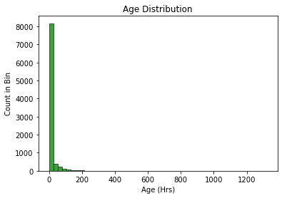
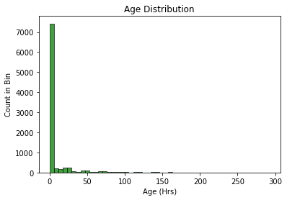
Exploratory Analysis
I already understood there to be relationships between Age_Hours and certain values of Team, as well as the length of the Action Notes
The longer a helpdesk ticket is open before it is closed, the more likely that it will a greater length of case notes, as well as resolution being handled by an L2 team – both features added later
I did find some outliers that needed to be dealt with in Age_Hours, with extreme values representing <0.002% of the data
BEFORE
AFTER

Slide 7
Baseline Modeling
4 classification models trained using 3 variations of X input:
Using only freeform text features (TF-IDF vocabulary)
All features excluding freeform text
All features combined
Most all models performed better when training with only freeform text input.
Some failed to train due to computational power demands or lack of convergence
Model | TFIDF | non-TFIDF | Combined
Random Forest | 0.61 | 0.22 | 0.60
Gradient Booster | Failed | 0.21 | Failed
Logistic Regression | 0.60 | Did not run | 0.27
SVM.LinearSVC | 0.68 | 0.02 | Failed

Slide 8
Extended Modeling
With the LinearSVC as the clear favorite, I worked to optimize the hyper parameters
Used HalfRandomSearchCV to tune C and Loss parameters
Found default parameter values to be the most effective

Slide 9
Conclusions and Recommendations
To improve performance, more data is needed.
This likely will require manual auditing of ticket classification by agents in order to produce more data which is accurately classified
Data must be accurately classified to use in model training
Recommend reducing the total unique classifications available to improve model (and manual agent) classification

Slide 10
Future Scope
Larger dataset to give more rows for each class in the target variable
Try more n-grams, such as 3 or even 4, to provide more richness to NLP
Reduce target classes to fewer selections to improve scores for remaining classes
Try a Neural net model
Better text pre-processing of Action Notes, which are cluttered with irrelevant words, e.g. email headers, agent IDs, date/times, etc
Build a set of sequential classifiers, one for Prod_cat1, then, for each available Prod_cat1 selection, build another to predict that class' Prod_cat2, then repeat for Prod_cat3. This would require well over 100 classifier models, which could be trained in an iterative loop

Slide 11
Thank You!
Q & A

